Slide 1
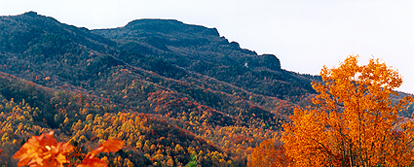
How do Erosion, Weathering, & Deposition alter the earth’s surface?
SPI 0407.7.1 Design a simple model to
illustrate how the wind and movement of
water alter the earth’s surface.

Slide 2
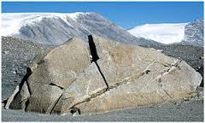
Weathering
Slow process that breaks rocks down into smaller pieces.
Flowing water, rain and wind are some causes of weathering. Even changes in temperature can weather rock.

Slide 3
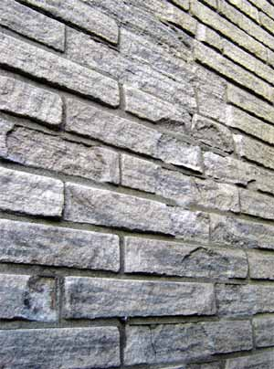
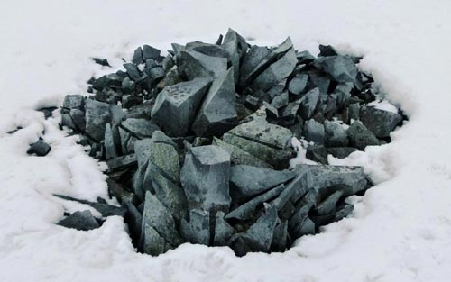
PHYSICAL WEATHERING
Water gets into cracks and joints in bedrock. When the water freezes it expands and the cracks are opened a little wider. Over time pieces of rock can split off a rock face and big boulders are broken into smaller rocks and gravel.
This process can also break up bricks on buildings.

Slide 4
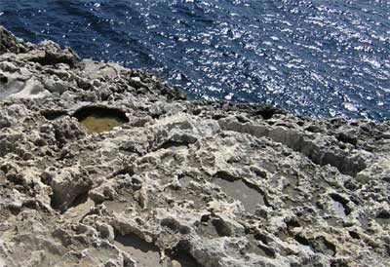
CHEMICAL WEATHERING decomposes or decays rocks and minerals. An example of chemical weathering is water dissolving limestone.

Slide 5
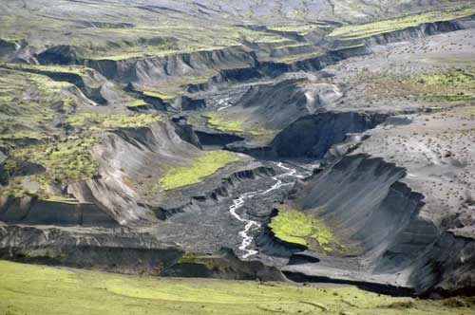
Erosion
The wearing away of rock
and the removal of
weathered rock and sediment.

Slide 6
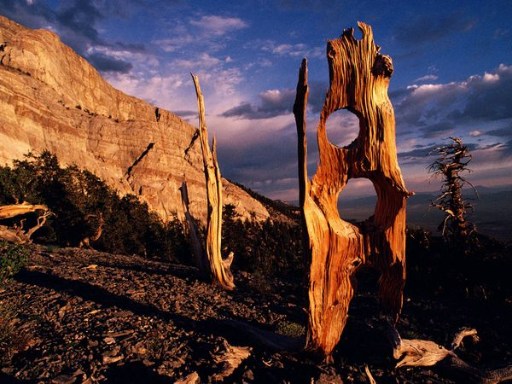
Eroded Trees
Persistent winds in the mountains of Nevada's Great Basin National Park eroded the trunk of this old pine tree into what look like a pair of sideways spectacles.

Slide 7
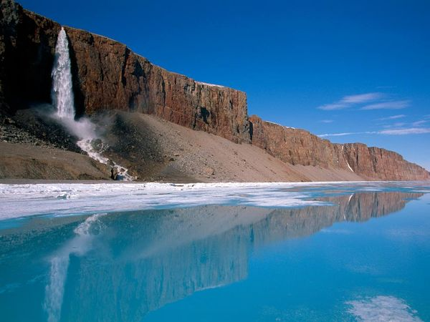
Baffin Island Waterfall

Slide 8
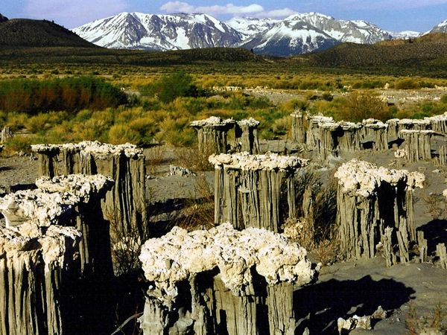
Sand Tufa
With the snow-draped Sierra Nevada as a backdrop, unique erosion formations called sand tufa stand like giant cauliflower stalks in a dry Arizona lake bed. Before this alkaline lake went dry, tufa formed when a freshwater spring percolated from below and formed calcium carbonate deposits. When the lake's level dropped, these fragile formations surfaced, and wind went to work removing the sand beneath the deposits.

Slide 9
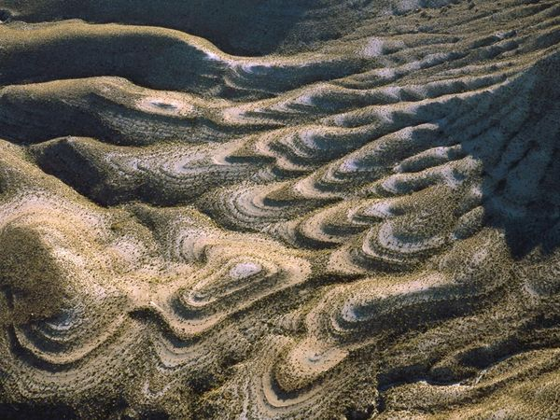
Limestone Swirls
Desert winds sculpted these gentle swirls out of the limestone hills in Black Gap Wildlife Management Area, Texas.

Slide 10
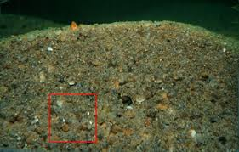
Sediment
Tiny pieces of rock, sand, and dirt

Slide 11
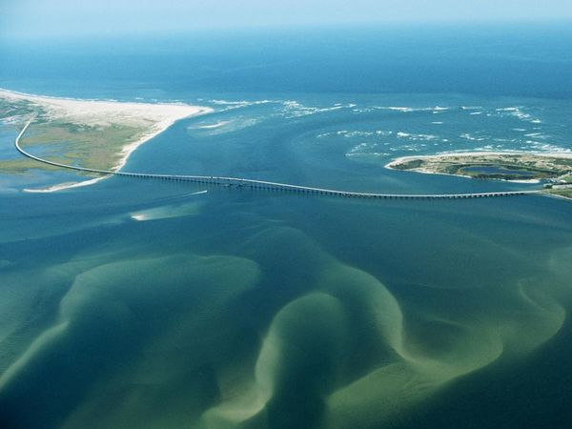
Deposition
When ice melts or wind and water slow down they can't carry as much sediment. The sediment is dropped, or deposited, in landforms.

Slide 12
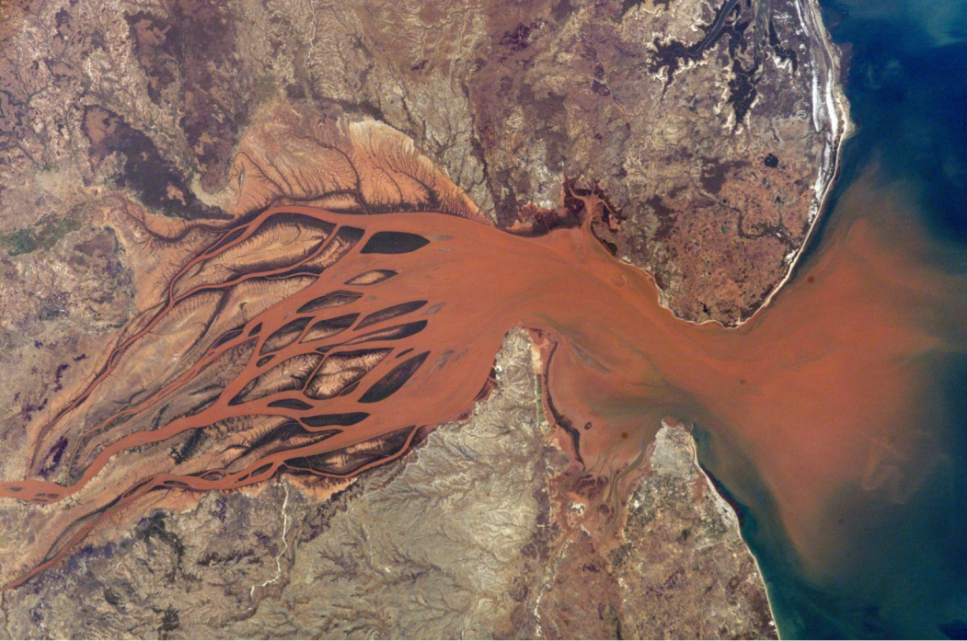
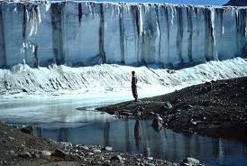
Delta
Glacier

Slide 13
How do you think the following land formations were created?
Erosion -OR- Weathering

Slide 14
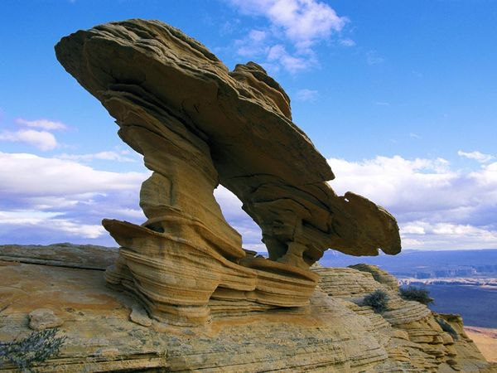
Weathering & Erosion

Slide 15
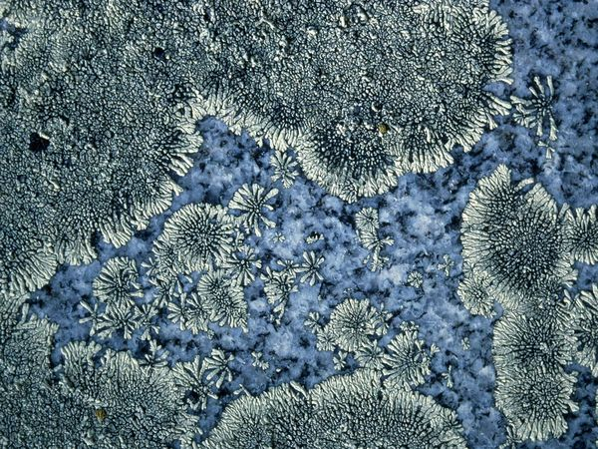
Weathering
White lichens cover a blue granite gravestone like snow near Lake Champlain, New York. Lichens, symbiotic organisms that combine fungi and algae secreting chemicals called chelates that work to break down rock.

Slide 16
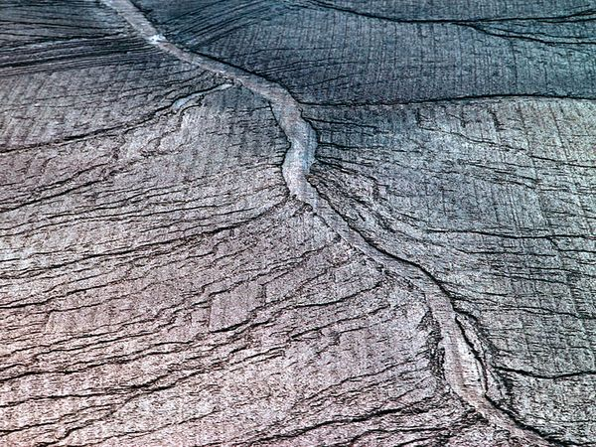
Soil Erosion
Heavy rains in northwest Iowa washed away soil, leaving this scarred tableau.

Slide 17
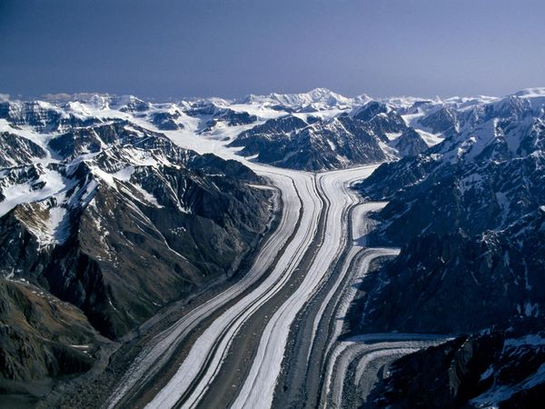
Depostion

Slide 18
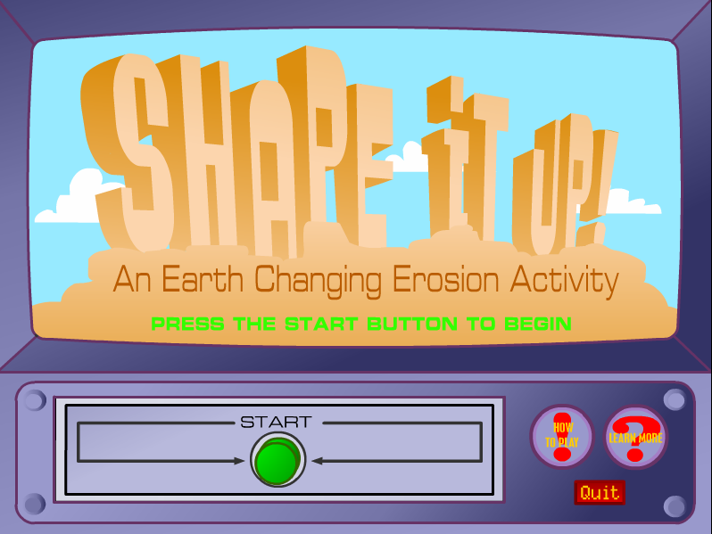
Let’s see what you learned!

