Slide 1
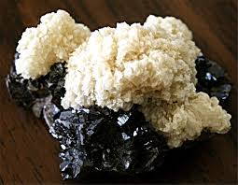
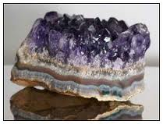
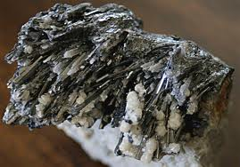
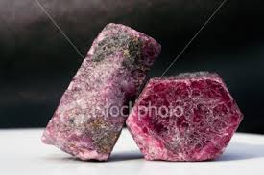
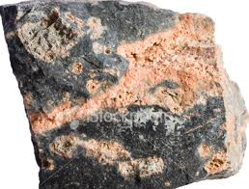
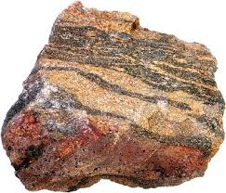
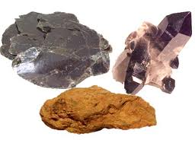
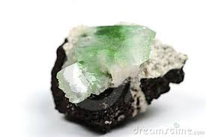
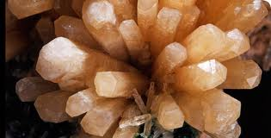
Rocks & Minerals
SPI 0407.7.2 Analyze how different earth materials are utilized to solve human problems or improve the quality of life.

Slide 2
Rocks and Minerals are examples of natural resources.
Natural resources are materials that
occur naturally on earth (not manmade).
Rocks and Minerals are also
non-renewable resources, meaning that once they are used, they cannot be replaced easily.

Slide 3
Rocks
Naturally occurring solid formed when one or more minerals come together
Sedimentary
Igneous
Metamorphic

Slide 4
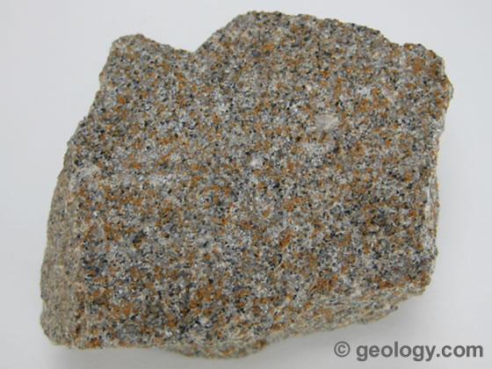
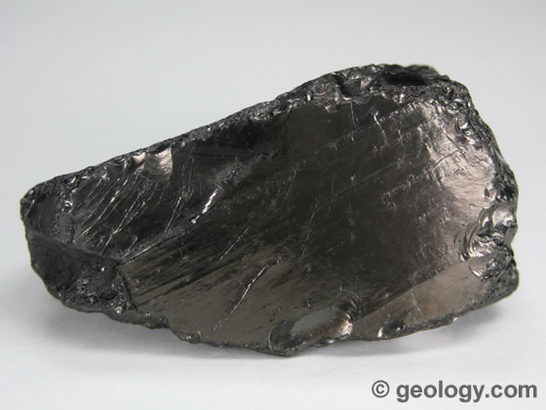
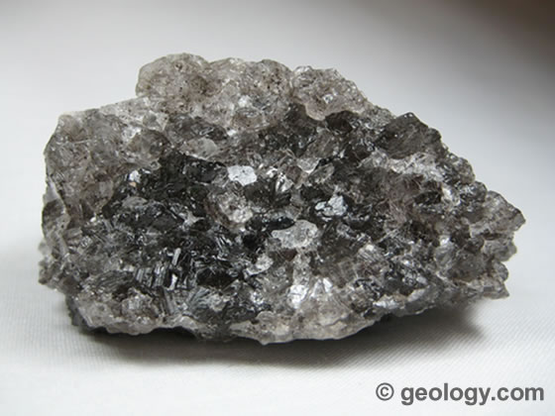
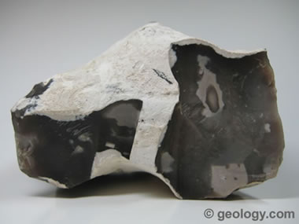
Sedimentary Rocks
When rocks are worn away by wind and rain, the broken-off pieces get transported down toward the seas by glaciers and rivers. They’re dumped when rivers lack the energy to carry them any farther. Particles and fragments build up like a layer cake as more debris piles on top. The long burial process squeezes the water out of this massive spongy sediment, turning it into solid rock.
SAND STONE COAL FLINT ROCK SALT

Slide 5
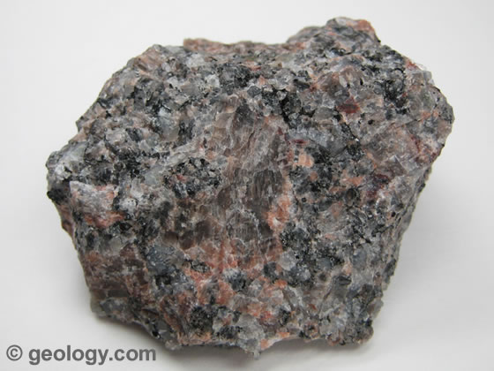
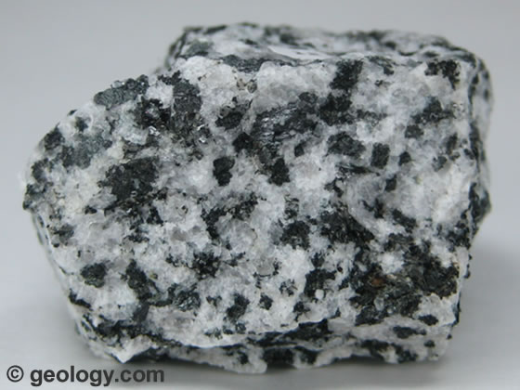
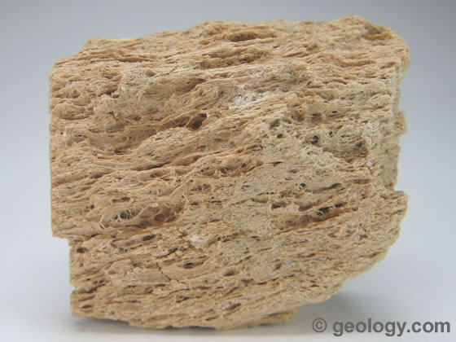
Igneous Rocks
This hot group start out as liquid rock deep within Earth. If they reach the surface, they spill out over the group as lava and explode out of volcanoes. When it cools, it forms a solid matrix of interlocking crystals.
GRANITE DIORITE PUMICE

Slide 6
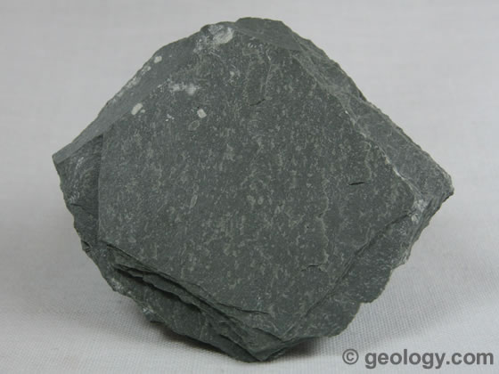
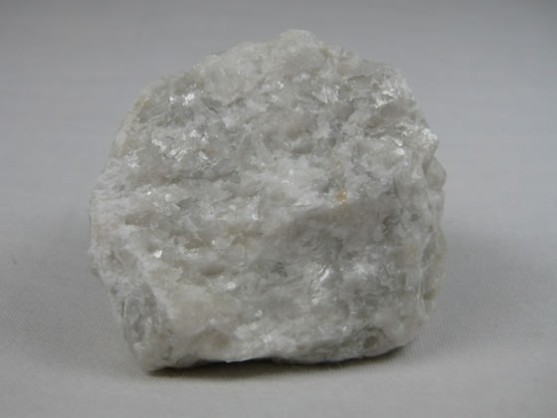
Metamorphic Rock
Start out as one type of rock but change when heated up or put under pressure.
SLATE MARBLE

Slide 7
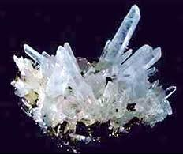
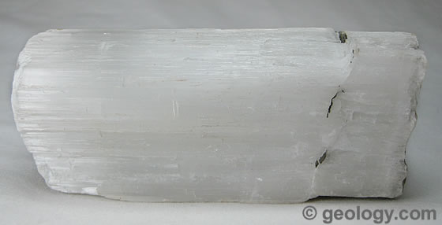
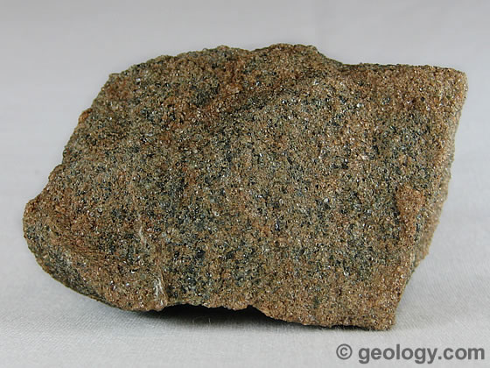
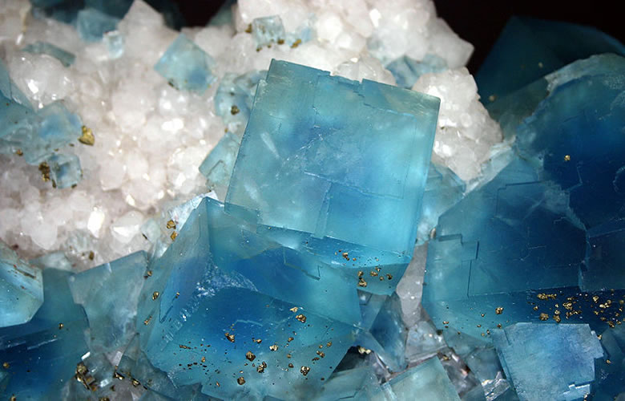
Minerals
Naturally occurring solid with definite chemical makeup.
QUARTZ GYPSUM
OLIVINE
FLURITE

Slide 8
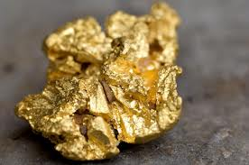
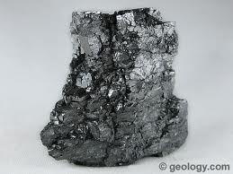
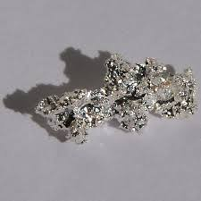
Purists
Unlike most minerals, they are made up of only one type of atom and are unearthed in the purest form possible-one element. These are the chemicals that make up the periodic table (including metals & nonmetals).
GOLD GRAPHITE SILVER

Slide 9
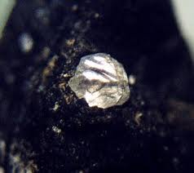
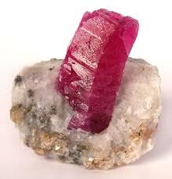
Gems
The group that dazzles & sparkles!! They are exceptionally fine looking crystals that are rare and hold a value. When cut and polished they become gemstones.
DIAMOND CORUNDUM

Slide 10
Mohs Scale Poster

