Slide 1
Do you have a question that you have always wanted to know the answer to?
If not… think about science topics that interest you:
Energy
Light
Animals & Plants
Water Cycle
Matter
Weather & Climate
Ecosystems
Electricity
Magnets

Slide 2
What’s the problem?
Your problem statement:
What do you want to find out?
What question do you want answered?
The Consumer’s Challenge (Bubble Gum) PROBLEM:_____________________________________

Slide 3
Research
Information about your topic found in books, online, or from people.
What is gum made of?
Does one particular substance make is chewy?
Compare what different brands of gum are made of?
The Consumer’s Challenge (Bubble Gum)
RESEARCH QUESTION:____________________________

Slide 4
Design Experiment
How will YOU test your question?
CAN YOU DO IT?
Make a list of materials and equipment you will need
The Consumer’s Challenge (Bubble Gum) EXPERIMENT:_____________________________________

Slide 5
Hypothesis
What do you think will happen?
DO THIS BEFORE YOU CONDUCT YOUR EXPERIMENT!!!
The Consumer’s Challenge (Bubble Gum) HYPOTHESIS:_____________________________________

Slide 6
Conduct Experiment (procedures)
Make observations with your senses and keep careful written records of what you did and saw.
LIST OF MATERIALS & TOOLS
PRODCEDURES:
If someone wanted to recreate your experiment these would be the directions they would follow. Don’t leave anything out!
Ex: recipe
The Consumer’s Challenge (Bubble Gum) PROCEDURES:_____________________________________

Slide 7
Results/Conclusions
Analyze your observations and draw conclusions.
Explain what happen and WHY.
You can include charts, graphs, or pictures to display results.
If you choose to, you may include a research paper. This is NOT required.
The Consumer’s Challenge (Bubble Gum) RESULTS:_____________________________________

Slide 8
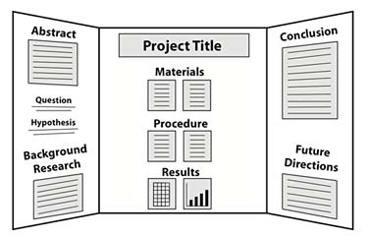
Prepare Your Exhibit
Your own creativity will determine how you will create your exhibit. You must include:
Title (question)
Statement of the Problem
Hypothesis
Results
Conclusions
Your exhibits should not exceed the size below. They may be smaller.
width- 32 inches
depth- 36 inches (front to back)
height- 48 inches above table surface

