Slide 1
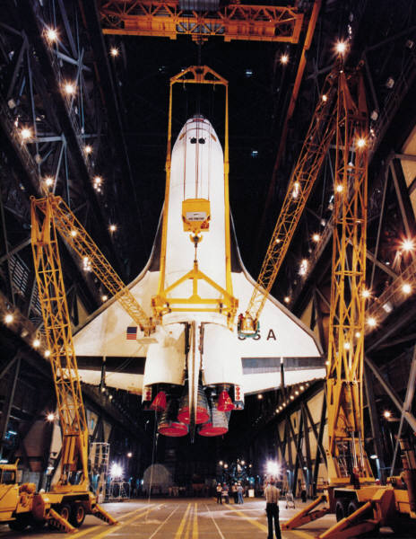


Technology & Scientific Advance
Science

Slide 2

Build a Boat….
How does this relate to science?

Slide 3
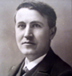
Technology
People, such as early inventors and scientists used science to invent technology to improve people’s lives.
Technology- everything we design, make and use to solve problems

Slide 4

Technology
We use technology to answer questions and solve problems. It is based on DEMAND
Demand- the need

Slide 5
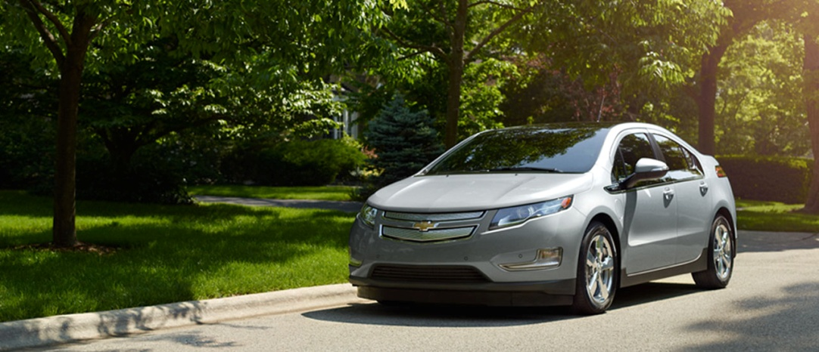
What technology is in high demand?
Medicine
Architecture
Media/ Entertainment
Education
Transportation
Industry

Slide 6
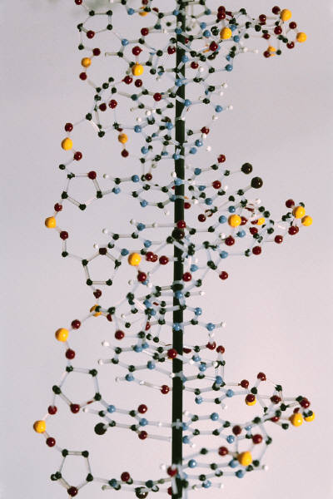
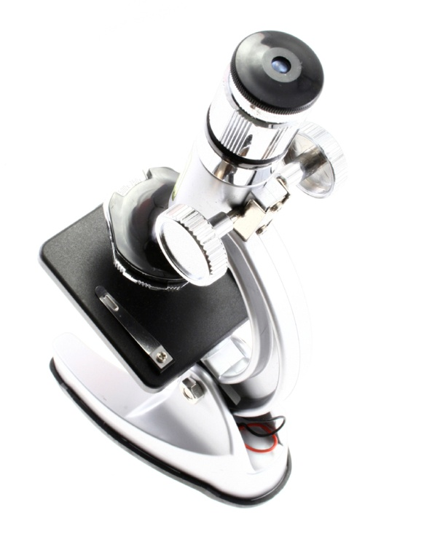
Scientific Advance
Is important scientific discoveries
Is important for all of these industries- group of businesses that provide similar goods or services

Slide 7
Who are the people making scientific discoveries?
Doctors
Scientists
Astronauts
Physicists
Engineers
Biologists

Slide 8
Lets take a look at some of our famous inventors and scientists…
Pierre Curie
Benjamin Franklin
Thomas Edison
Steve Jobs
Wilbur & Orville Wright
Levi Strauss
Henry Ford

Slide 9
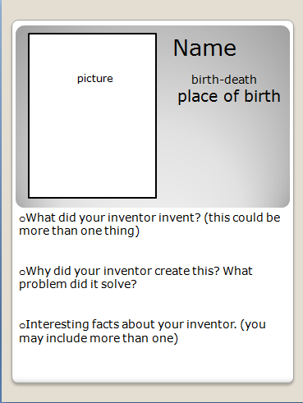

Slide 10
How does the U.S. compare to other countries?
China
Russia
Japan
England

Slide 11
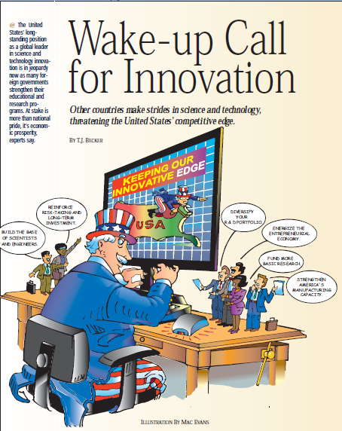

Slide 12

Do you buy “Made in the USA”?
What are some solutions? How can we improve our technology?
Do you think it is important for the U.S. To have scientific advance?

Slide 13
Steps in the Designing Process
They went through the same process you did to invent or discover new technology
Identify Problem
Propose a Solution
Build a Model
Test the Design
Explain the Invention

Slide 14
Let’s Practice…
Your kite gets stuck in a tall tree.
Identify Problem
Propose a Solution
Build a Model
Test the Design
Explain the Invention

Slide 15
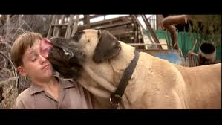
The Sandlot

Slide 16
Invention Design
What problem does your invention or technology solve?
How does the invention or technology impact people?

